Slide 1
Applied Machine Learning SEZG568/SSZG568
Dr Y V K RAVI KUMAR
yvk.ravikumar@pilani.bits-pilani.ac.in

Slide 2
Session 12(28th October,2023)

Slide 3
Session 12 – 28th October,2023
12 | Artificial Neural Networks: Perceptions, Delta rule, Design for Boolean logic gates and linear classification, Neural networks, Design for nonlinear classification and Boolean functions, Backpropagation algorithm | T1: Chapter 10 T2: Chapter 5

Slide 4
Probabilistic Clustering
Represent the probability distribution of the data as a mixture model
captures uncertainty in cluster assignments
gives model for data distribution
Bayesian mixture model allows us to determine K
Consider mixtures of Gaussians

Slide 5
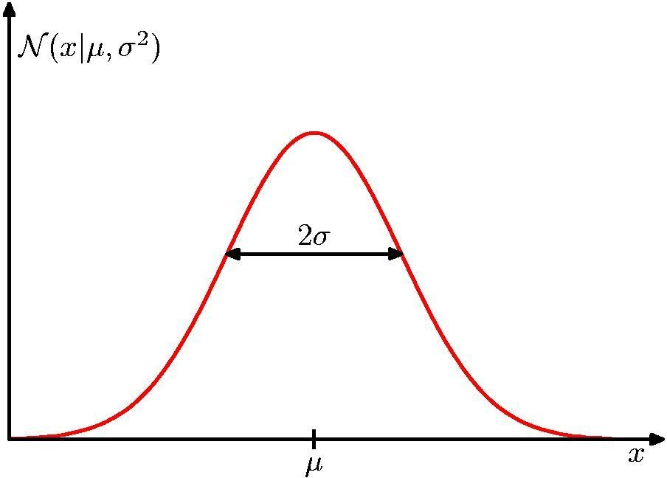
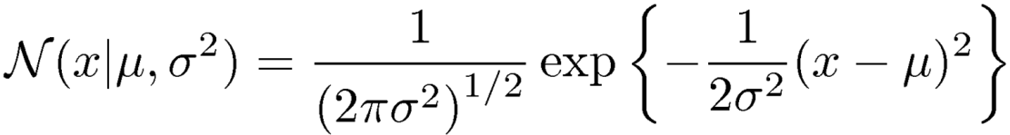
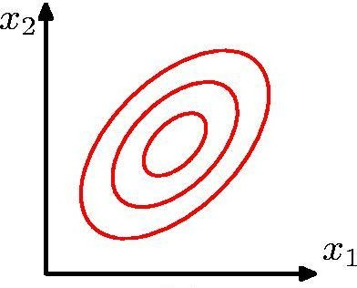
Review: Gaussian Distribution

Slide 6
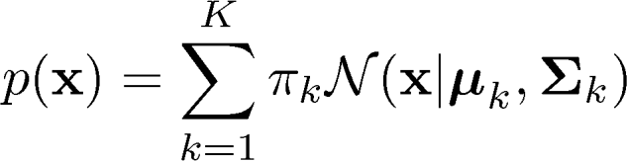
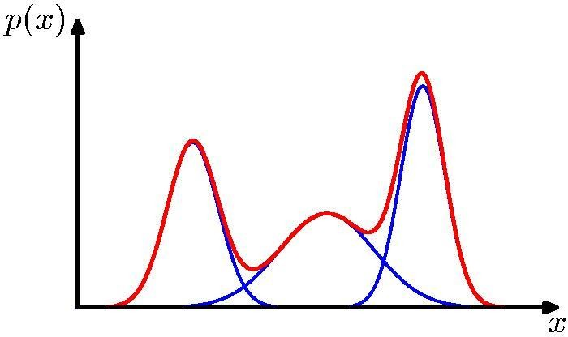
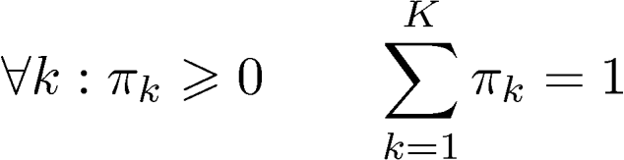
Mixtures of Gaussians
Combine simple models into a complex model:
Component Mixing coefficient
K=3
Find parameters through EM (Expectation Maximization) algorithm

Slide 7
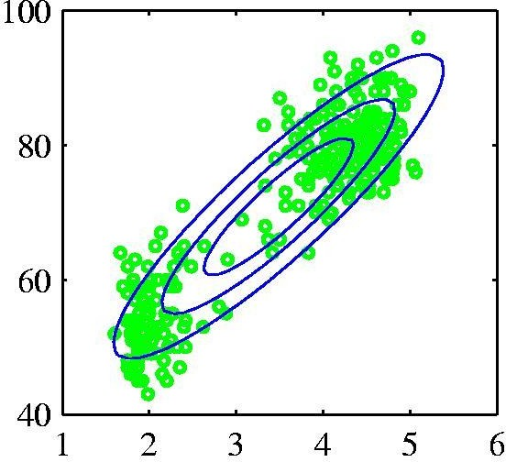
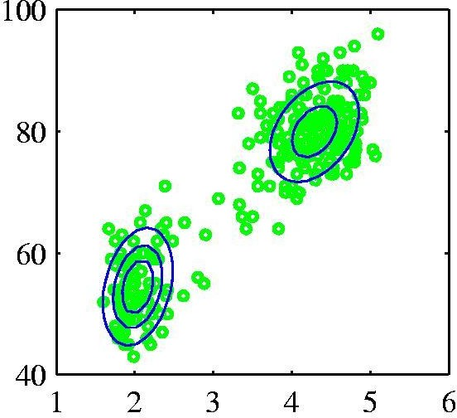
Probabilistic version: Mixtures of Gaussians
Single Gaussian
Mixture of two
Gaussians

Slide 8
Roots of neural networks
Neurobiological studies:
How do nerves behave when stimulated by different magnitudes of electric current?
Is there a minimal threshold needed for nerves to be activated?
How do different nerve cells communicate among each other?
Psychological studies:
How do animals learn, forget, recognize and perform various types of tasks?
Psycho-physical: Experiments help to understand how individual neurons and groups of neurons work.
McCulloch and Pitts introduced the first mathematical model of single neuron, widely applied in subsequent work. ( we’ll look at this)

Slide 9
Biological Neurons
Human information processing system consists of brain neuron: basic building block
cell that communicates information to and from various parts of body
Simplest model of a neuron: considered as a threshold unit –a processing element (PE)
Collects inputs & produces output if the sum of the input exceeds an internal threshold value
dendrites
cell
axon
synapse
dendrites

Slide 10
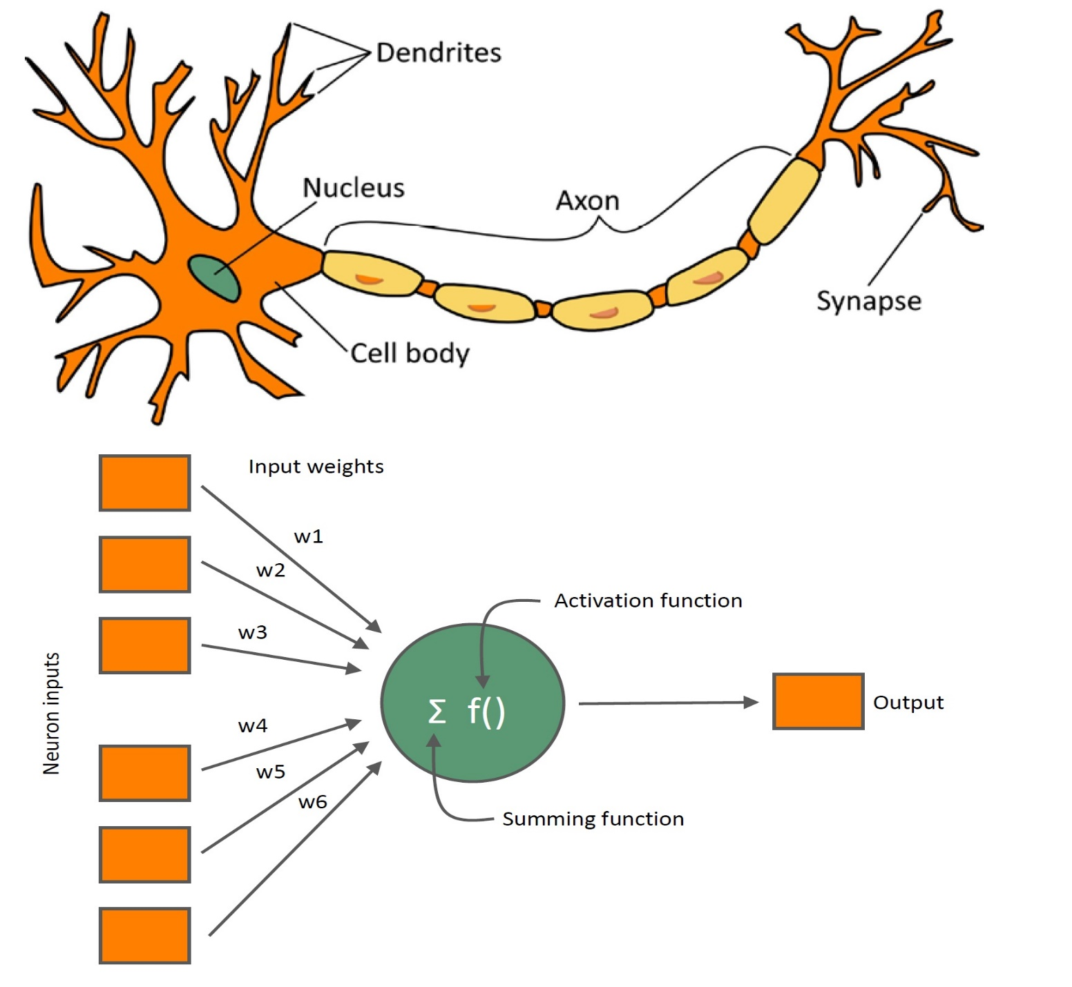

Slide 11
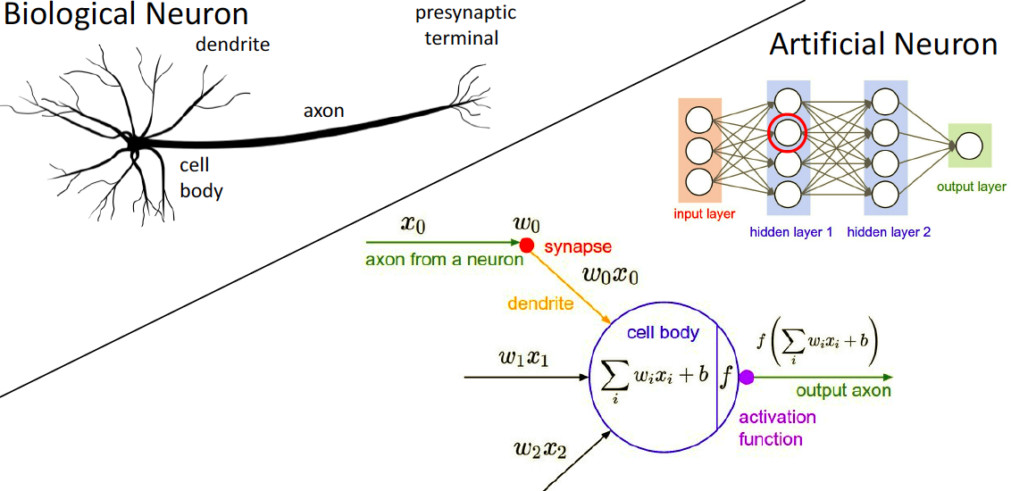
Our brains are made of Neurons

Slide 12
Linear Classification
Consider Following data
x₁ | X₂ | y
1 | 9 | Green
10 | 9 | Green
4 | 7 | Green
4 | 5 | Red
5 | 3 | Red
8 | 9 | Green
4 | 2 | Red
2 | 5 | Red
7 | 1 | Red
2 | 10 | Green
8 | 5 | Green
1 | 2 | Red
8 | 2 | Red
Data is in 2D, so let us visualize
x₂
x₁
Data looks linearly separable
What is the decision boundary?
Many Possibilities, such as
if (2x₁ + 3x₂ − 25 > 0) it is green
otherwise red

Slide 13

What about this arrangement?
With chosen decision boundary 2x₁ + 3x₂ − 25 = 0
x₂
-25
x₁
2
sign
x₂
3
x₁
This illustration is called as perceptron
Provides a graphical way to represent the linear boundary
Values 3, 2, -25 are its parameters or weights
Given a data
“How to find appropriate parameters?” is an important issue

Slide 14
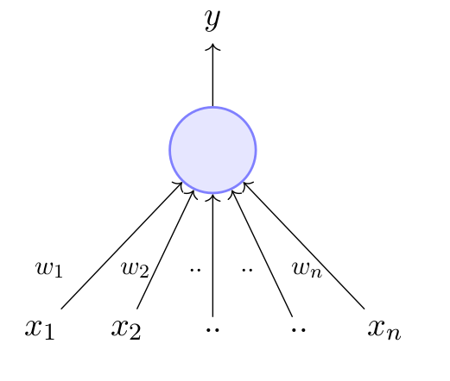
The Perceptron
A perceptron takes a vector of real-valued inputs, calculates a linear combination of these inputs, then outputs 1 if the result is greater than some threshold and -1 otherwise.

Slide 15

An Example
Design a perceptron for
We have following four equations
w₀ + w₁ × (0) + w₂ × (0) < 0 (1)
w₀ + w₁ × (0) + w₂ × (1) < 0 (2)
w₀ + w₁ × (1) + w₂ × (0) ≥ 0 (3)
w₀ + w₁ × (1) + w₂ × (1) < 0 (4)
X₁ | x₂ | Classification
0 | 0 | 0
0 | 1 | 0
1 | 0 | 1
1 | 1 | 0
By (1) w₀ < 0 so let w₀ = −1
Let us assume following
By (2) w₀+w₂<0 so let w₂ = −1
+1
By (3) w₀+w₁≥0 so let w₁ = 1.5
w₀
By (4) w₀+w₁+w₂<0 that is valid
x
w₁
σ(w ^{T} x )
So (w₀, w₁, w₂) = (−1, −1, 1.5)
1
Other possibilities are also there
x
2
w₂

Slide 16
An Example
Design a perceptron for
We have following four equations
w₀ + w₁ × (0) + w₂ × (0) < 0 (1)
w₀ + w₁ × (0) + w₂ × (1) < 0 (2)
w₀ + w₁ × (1) + w₂ × (0) ≥ 0 (3)
w₀ + w₁ × (1) + w₂ × (1) < 0 (4)
X₁ | x₂ | Classification
0 | 0 | 0
0 | 1 | 0
1 | 0 | 1
1 | 1 | 0
By (1) w₀ < 0 so let w₀ = −1
By (2) w₀+w₂<0 so let w₂ = −1
By (3) w₀+w₁≥0 so let w₁ = 1.5
By (4) w₀+w₁+w₂<0 that is valid
So (w₀, w₁, w₂) = (−1, −1, 1.5)
Other possibilities are also there

Slide 17
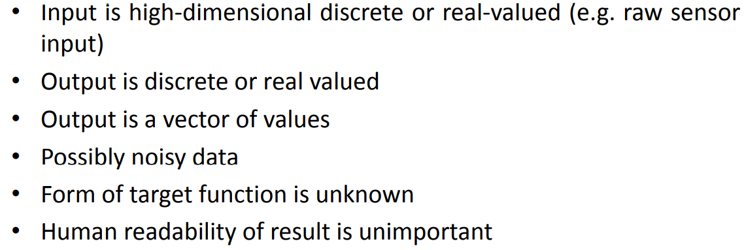
When to use Neural Network

Slide 18
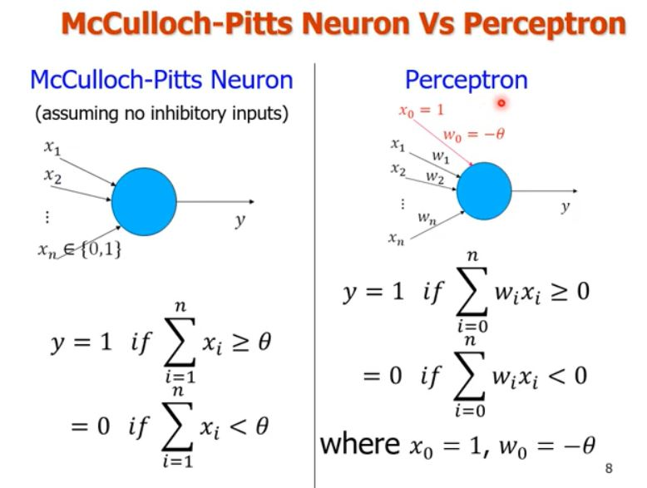
McCulloch-Pitts Neuron Vs Perceptron

Slide 19
Perceptron

Slide 20
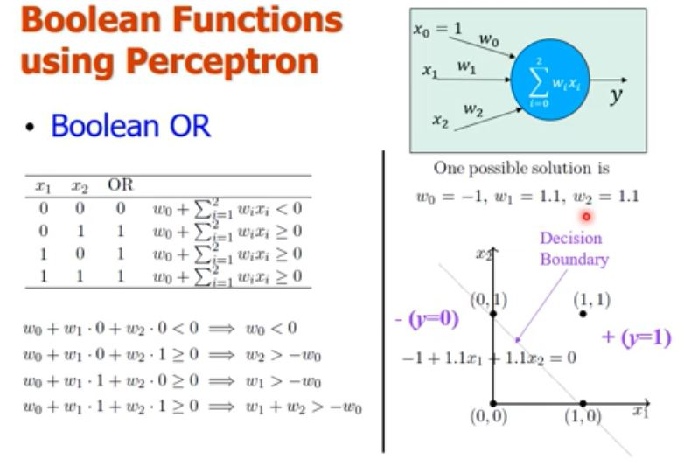

Slide 21
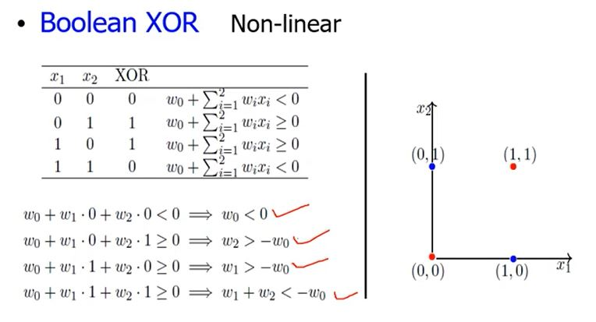

Slide 22
X1 | X2 | Classification
0 | 0 | 0
0 | 1 | 0
1 | 0 | 1
1 | 1 | 0

Slide 23
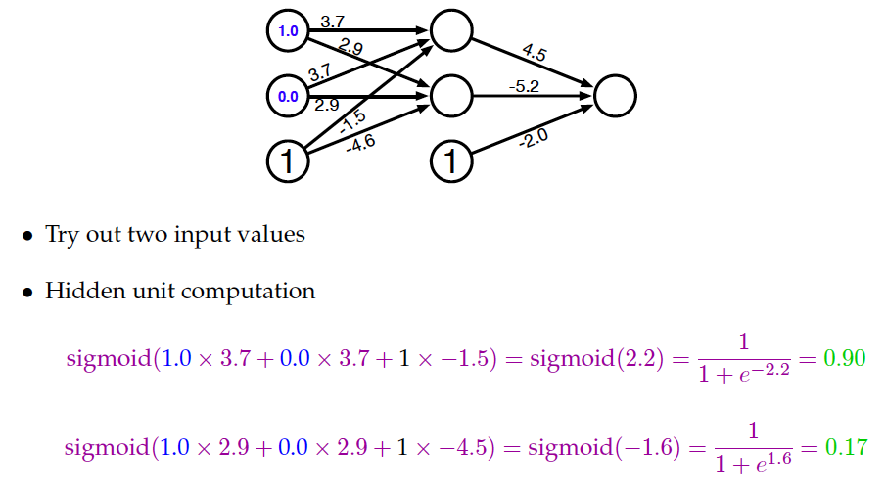
Revisit to Simple NN- Sample Input

Slide 24
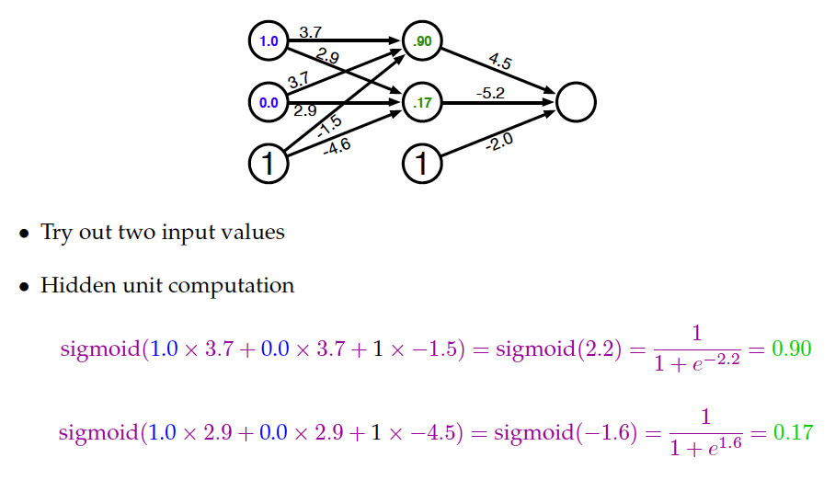
Revisit to Simple NN- Computed Hidden

Slide 25
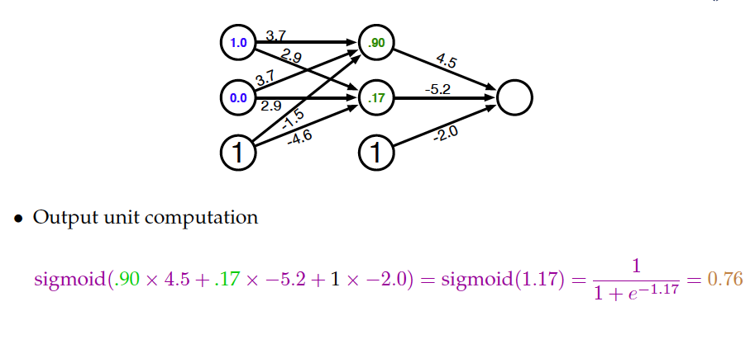
Revisit to Simple NN- Compute Output

Slide 26
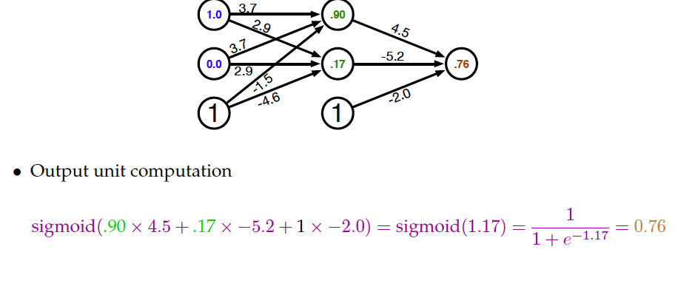
Revisit to Simple NN- Computed Output

Slide 27
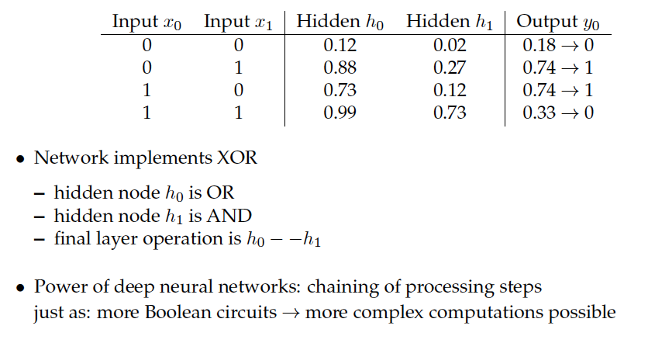
Output for all Binary Inputs

Slide 28
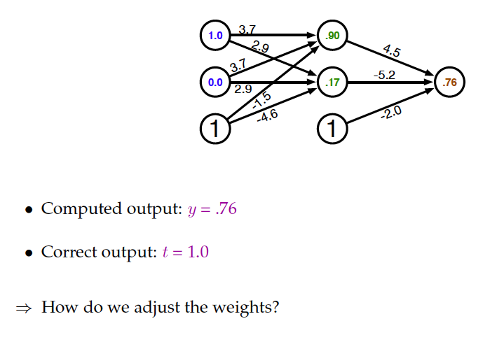
Error

Slide 31
Network Architecture
Three different classes of network architectures
single-layer feed-forward
multi-layer feed-forward
Backward
The architecture of a neural network is linked with the learning algorithm used to train

Slide 32
Single-Layer Feed forward
Input layer
of
source nodes
Output layer
of
neurons

Slide 33
Multi-Layer Feed forward
Input
layer
Output
layer
Hidden Layer

Slide 34
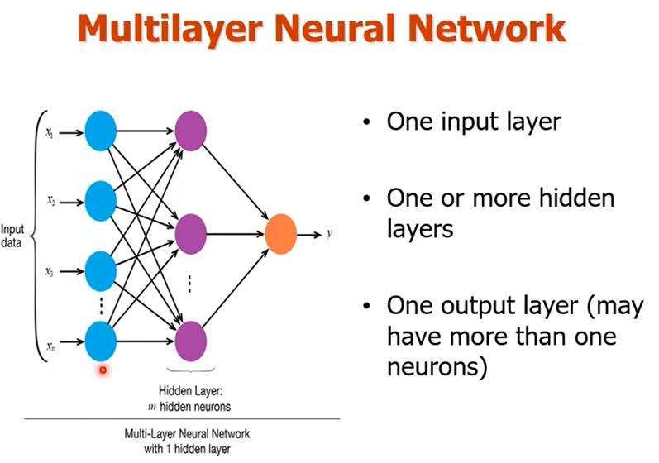
Multilayer Networks

Slide 35
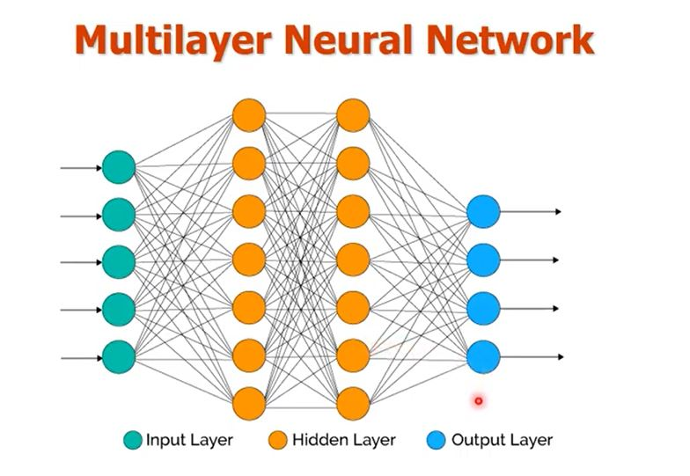
Multilayer Networks

Slide 36
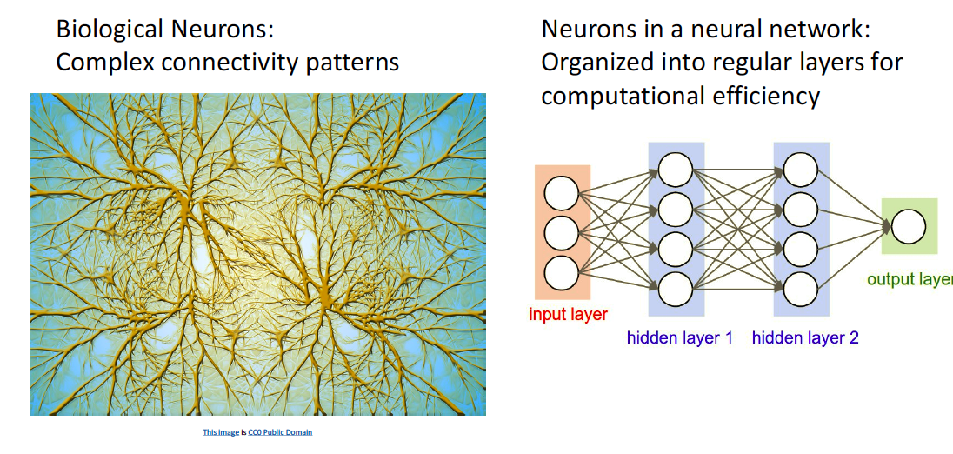
Our brains are made of Neurons

Slide 37
Activation function

Slide 38
Activation function

Slide 39
Activation function

Slide 40
Activation function

Slide 41
Activation function

Slide 42
Activation function

Slide 43
Activation function

Slide 44
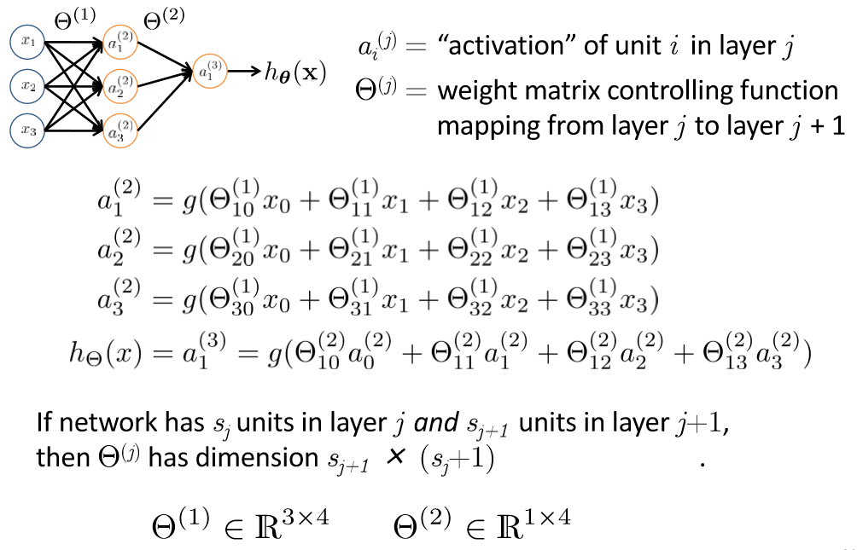
Neural Network

Slide 45
Backpropagation

Slide 46
Error

Slide 47
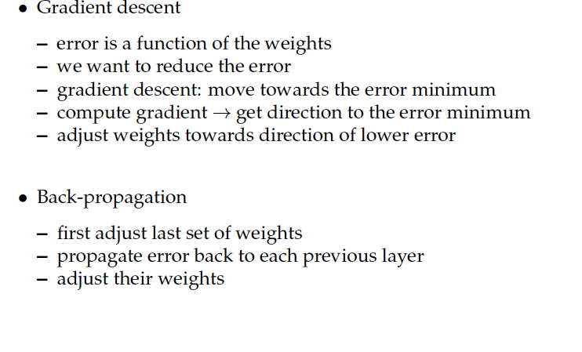
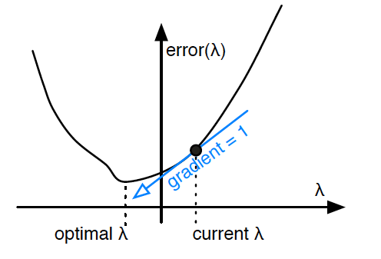
Key Concepts

Slide 48
Backpropagation: Purpose and Implementation
Purpose: To compute the weights of a feedforward multilayer neural network adaptatively, given a set of labeled training examples.
Method: By minimizing the following cost function (the sum of square error):
E= 1/2 Σn (y^{n}-h(x^{n}))²

Slide 49
Backpropagation: Overview
Backpropagation works by applying the gradient descent rule to a feedforward network.
The algorithm is composed of two parts that get repeated over and over until a pre-set maximal number of epochs
Part I, the feedforward pass: the activation values of the hidden and then output units are computed.
Part II, the backpropagation pass: the weights of the network are updated--starting with the hidden to output weights and followed by the input to hidden weights--with respect to the sum of squares error and through a series of weight update rules called the Delta Rule.

Slide 50
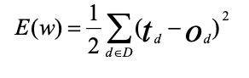
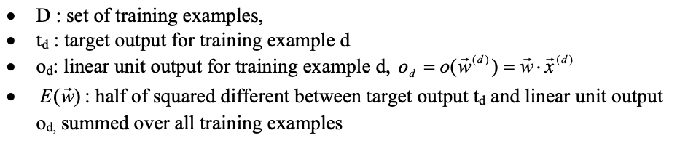
Backpropagation: Delta rule
The delta training rule is best understood as training an unthresholded perceptron, which is a linear unit with output o given as follows:
o(x) = w ⋅ x
Training error of a hypothesis relative to the training examples is as follows:

Slide 51
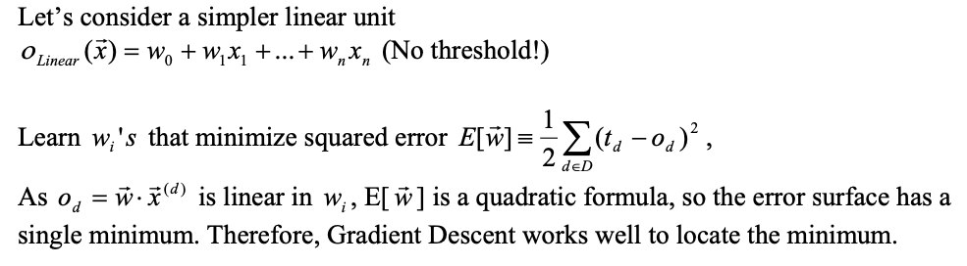
Backpropagation: Delta rule

Slide 52
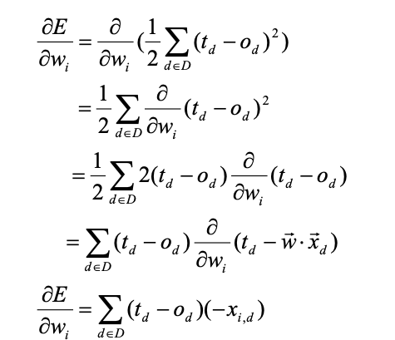
Derivation of the Gradient Descent Rule

Slide 53
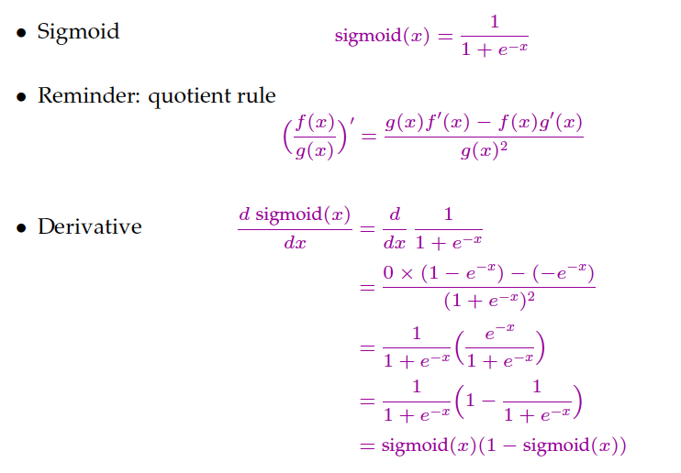
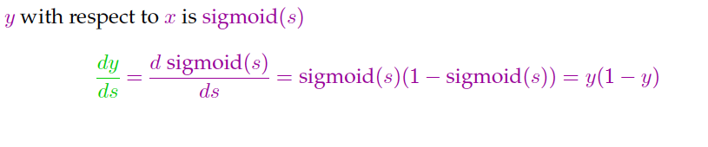
Learning in NN- Backpropagation- Example

Slide 69
Thank You!

